Slide 1


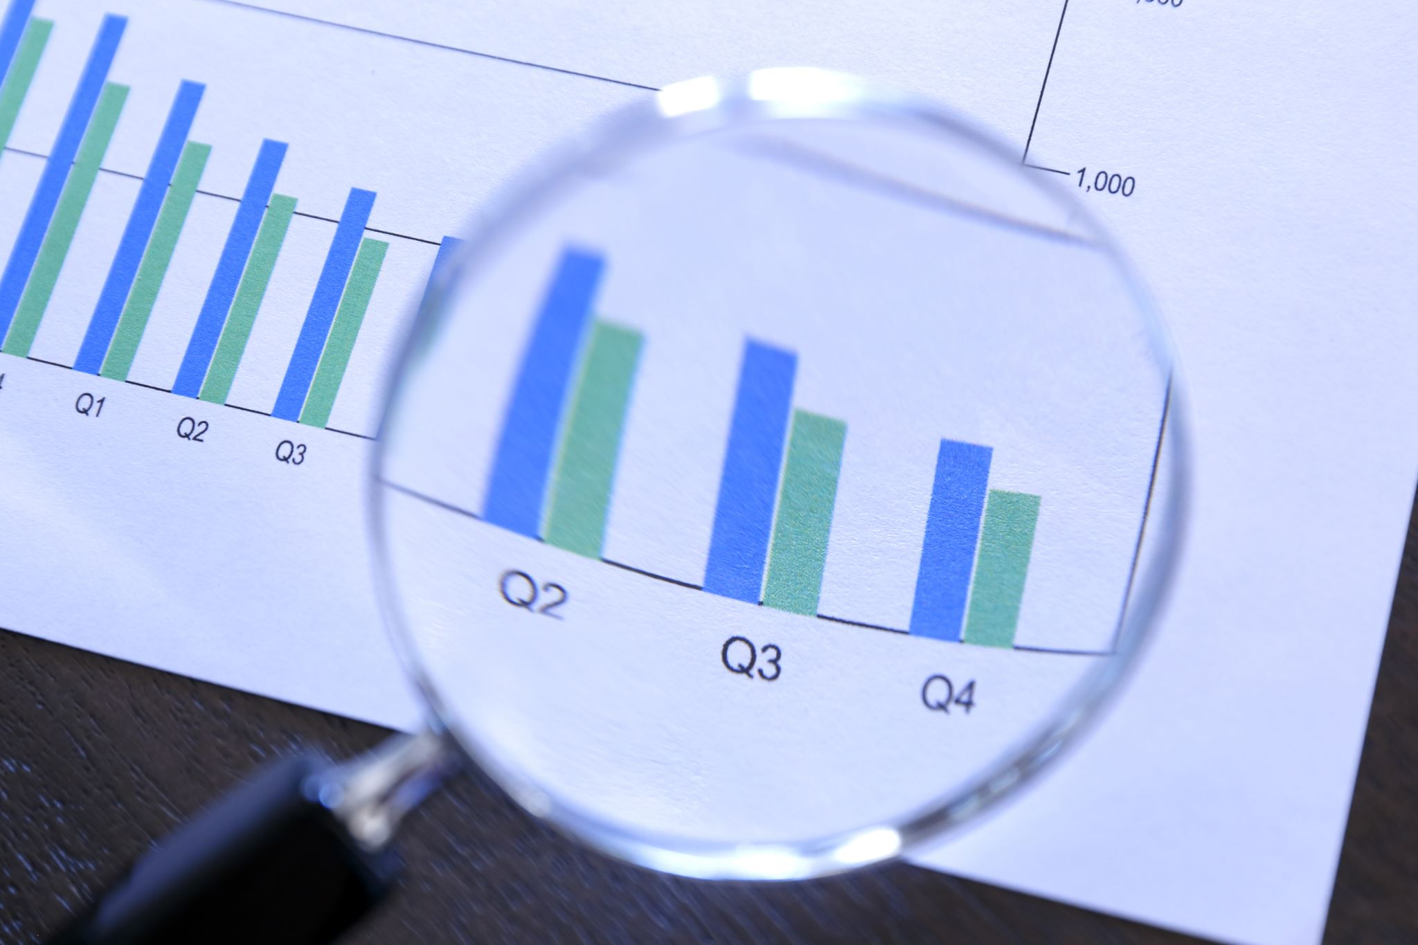


Day 3: Data Analysis and Visualization Techniques
Enhancing Research Impact: Tools and Techniques for Effective Publishing

Slide 2

Session Overview
Data Analysis – An Introduction
Mastering data visualization with Python libraries and KNIME.
Understanding the importance of visualization in research.
Hands-on activities for practical learning.

Slide 3
Data Analysis vs Data Analytics
Understanding the differences and relationship

Slide 4
Overview
Data analytics is a broader discipline that includes data analysis as a subset.
Data analysis focuses on summarizing and understanding historical data.
Data analytics involves descriptive, diagnostic, predictive, and prescriptive techniques.

Slide 5
Definitions
Data Analysis
A process of summarizing, organizing, and exploring historical data to identify patterns and trends.
Data Analytics
A broader field that encompasses advanced techniques like predictive modeling, optimization, and real-time analysis.

Slide 6
Key Differences
Aspect | Data Analysis | Data Analytics
Position | Subset of data analytics. | Broader discipline that includes data analysis.
Focus | Descriptive and diagnostic analysis of historical data. | Includes descriptive, diagnostic, predictive, and prescriptive analytics.
Purpose | Understanding and summarizing data. | Solving specific business problems and making data-driven decisions.

Slide 7
Techniques and Tools
Data Analysis:
Descriptive statistics, EDA, visualizations (excel, tableau, python - matplotlib, seaborn).
Data Analytics:
Machine learning,
Advanced BI tools (R, python, Apache spark, KNIME, tableau).

Slide 8
Relationship
Data analysis is a foundational step within data analytics.
It focuses on understanding historical data ("what happened?").
Data analytics is broader and includes predictive and prescriptive insights ("what will happen?" And "what should we do?").
It builds on insights from data analysis to make predictions and recommendations.
Together, they form the basis for data-driven decision-making.

Slide 9
Importance of Data Analysis and Visualization in Research
Data analysis helps identify patterns, trends, and insights in research data.
Supports evidence-based conclusions, enhancing the credibility of research.
Enhances the clarity and understanding of research findings.
Facilitates impactful communication of results through visual storytelling

Slide 10
Objectives of Data Analysis and Visualization In Publishing
Organize and summarize research data.
Highlight trends, outliers, and relationships.
Generate insights that address key research questions.
Create visually compelling narratives to improve research dissemination.

Slide 11
Techniques for Effective Data Analysis
Data Cleaning and Preprocessing: Ensure data accuracy and consistency.
Statistical Analysis: Use descriptive and inferential statistics to summarize data.
Exploratory Data Analysis (EDA): Identify key patterns and relationships.

Slide 12
Visualization Techniques
Static Visualizations: Bar charts, line plots, scatter plots.
Interactive Visualizations: Dashboards, heatmaps, and 3D plots.
Dynamic Visualizations: Real-time data streaming and interactive web-based tools.

Slide 13
Tools for Research Data Analysis and Visualization
Python Libraries: Pandas, Matplotlib, Seaborn, Plotly and Bokeh for Data Processing And Visualization.
KNIME: Automate Workflows for Large-scale Data Analysis.

Slide 14
Python Libraries for Data Analysis
Numpy
Pandas
Scikit-learn

Slide 15
Numpy
For Numerical Computing
Working with arrays
Basic operations
https://numpy.org/doc/stable/user/absolute_beginners.html
https://media.geeksforgeeks.org/wp-content/uploads/20240104182515/NumPy-Cheat-Sheet.pdf

Slide 16
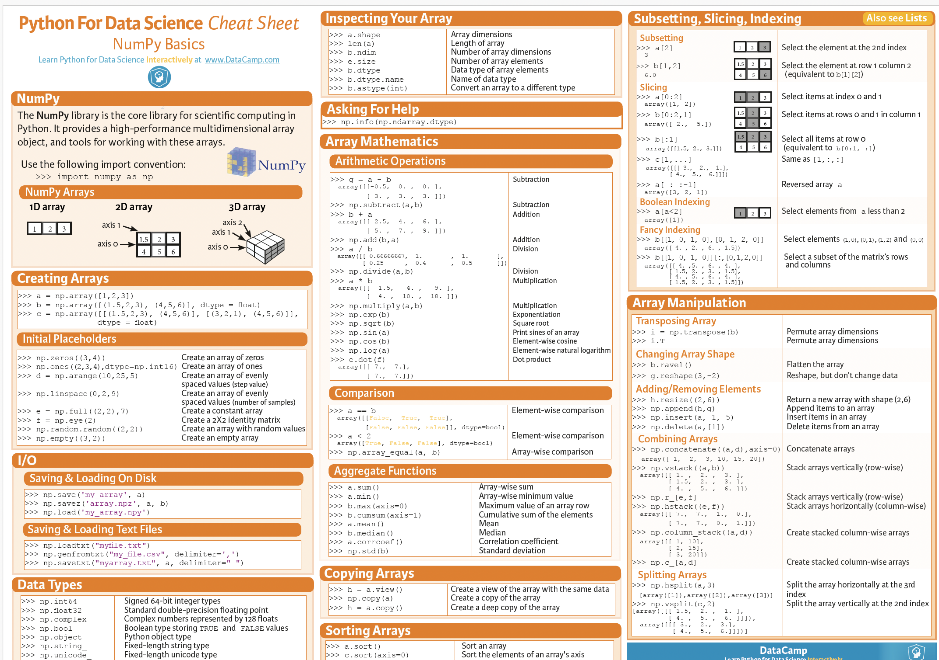

Slide 17
Pandas
For data manipulation, exploration and analysis
https://pandas.pydata.org/docs/getting_started/index.html
https://www.geeksforgeeks.org/pandas-cheat-sheet/

Slide 18
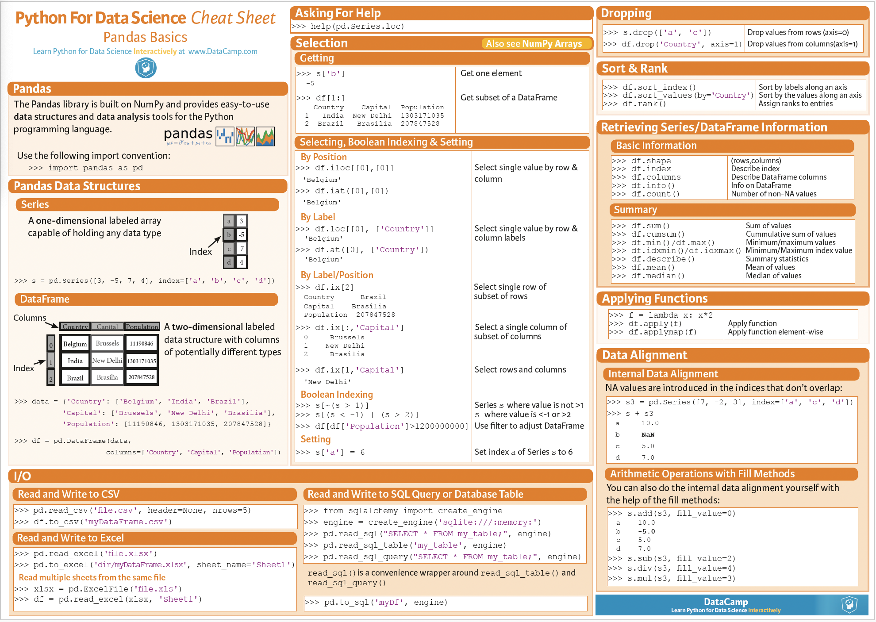

Slide 19
Scikit-learn
For Machine Learning
https://scikit-learn.org/stable/

Slide 20
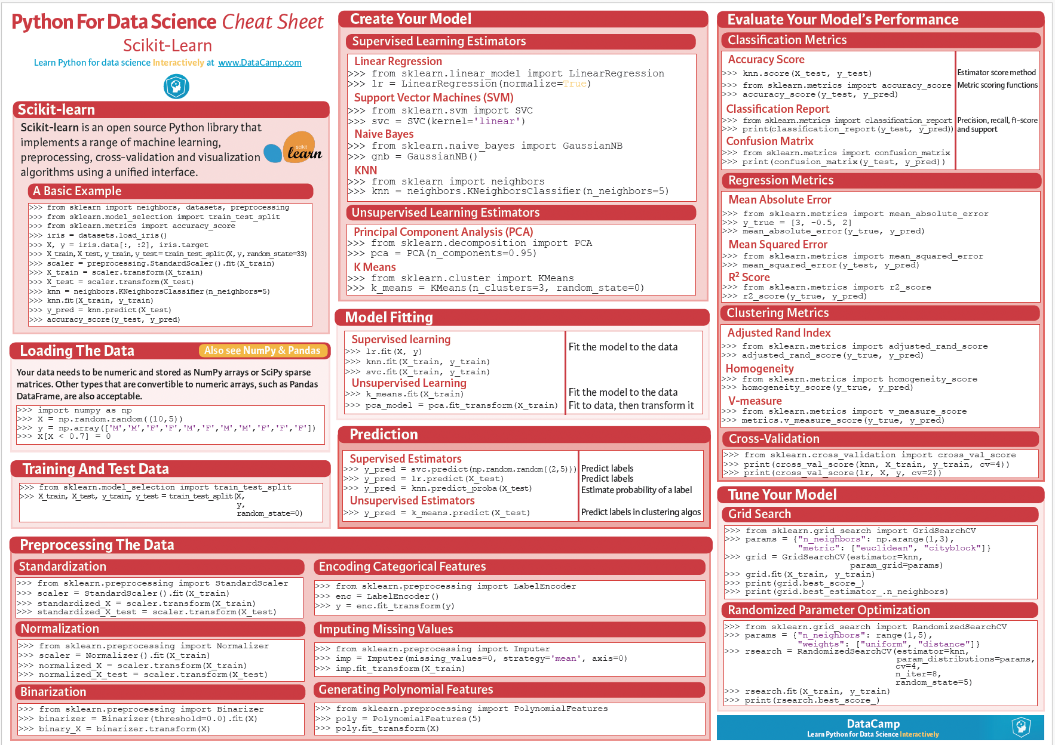

Slide 21
Data Visualization
The greatest value of a picture is when it forces us to notice what we never expected to see.
- John Tukey

Slide 22
KNIME for Automated Visualization
Setting up workflows in KNIME.
Using visualization nodes (histograms, scatter plots, line charts).
Automating data preprocessing and exporting insights.

Slide 23
Enhancing Research Impact
Leverage high-quality data visualizations to communicate findings effectively.
Use analytical insights to address societal challenges or industry needs.
Collaborate across disciplines to make research impactful.

Slide 24
Summary and Next Steps
Data Analysis is a cornerstone of impactful research and publishing.
Utilize modern tools and techniques to maximize research visibility.
Focus on clear, evidence-based storytelling to engage readers and reviewers.

